Slide 1







R Fundamentals Bootcamp
You should have R & RStudio installed
https://sites.northwestern.edu/researchcomputing/resources/r-and-rstudio/
We start at 9:30am
Coffee available!
Download the materials from GitHub
https://github.com/nuitrcs/R-fundamentals-august-2025
Get help from Northwestern IT Research Computing and Data Services!
Get 1-1 help from us! – bit.ly/rcdsconsult
Bring Your Own Data (BYOD) working groups – bit.ly/byod_groups
Collaborative Project Support – bit.ly/collaborative_project_support

Slide 2

Research Computing and Data Services
Instructors:
Ritika Giri
Emilio Lehoucq
Northwestern IT
Teaching Assistants: Anthony Pulvino
David Nichols

Slide 3
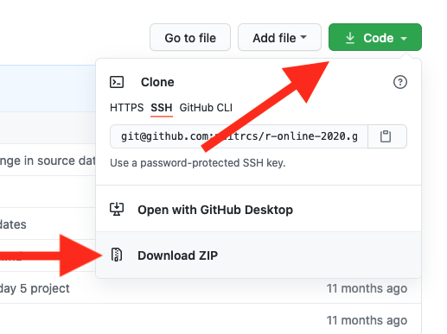
Download materials from github
Step 1: Download as a zip file
Step 2: Unzip the downloaded file
Click on Code
Click on Download Zip
MacOS
Go to “Downloads”
Double-click the file to unzip
Move unzipped folder to desired place (like Documents or Desktop)
Windows
Go to “Downloads”
Right click on the file, then select “Extract All”
Select the desired destination to extract to in the pop-up dialog box
See also: https://www.lifewire.com/unzip-files-windows-11-8425832
Instructions: https://sites.northwestern.edu/researchcomputing/resources/downloading-from-github/

Slide 4
This workshop is brought to you by:
Northwestern IT Research Computing and Data Services
Need help?
AI, Machine Learning, Data Science
Statistics
Visualization
Collecting web data (scraping, APIs), text analysis, extracting information from text
Cleaning, transforming, reformatting, and wrangling data
Automating repetitive research tasks
Research reproducibility and replicability
Programming, computing, data management, etc.
R, Python, SQL, MATLAB, Stata, SPSS, SAS, etc.
Request a FREE consultation at bit.ly/rcdsconsult.

Slide 5
Collaborative project support
If you're a faculty (or postdoc, research staff, or graduate student with faculty sponsorship), we can provide longer-term support in your project.
We can help from exploration (is this idea possible?) to concrete outcomes (e.g., data collection, cleaning, analysis or visualization for a publication).
Find more information at bit.ly/collaborative_project_support

Slide 6
Bring Your Own Data (BYOD)
Do you have research data waiting to be collected, cleaned, analyzed or visualized?
Come to BYOD.
BYOD is a weekly working group that provides structure, guidance, and accountability to help you make progress on your research project in a supportive and stress-free environment.
Find more information at bit.ly/byod_groups

Slide 7
Sticky Notes
I'm done/
doing OK
I need help/
I'm stuck

Slide 8

Who are you?
Done any coding before?
Majoring in?
Love cats?
Feeling apprehensive?
Feeling confident?
Used R before?

Slide 9
Talk to each other!
This is a great opportunity to meet other people that are learning how to code!
You can learn from each other and even stay in touch ☺

Slide 10
What to expect this week
Please be ready to start at 9:30am. We have a lot to cover! ⏰
9:30am – 12pm: morning session
12pm – 1pm: lunch and nap!
1pm – 4pm: afternoon session
Breaks in between
We have coffee! Feel free to refill your cup as needed ☕️
Come talk to us during breaks or before and after sessions!
We love chatting and are here to help you with your research 🙂

Slide 11
This is a hands-on workshop!
We cover a mini-concept
You see example code to implement the concept in R using our classroom dataset (health data)
You write code to complete a mini coding exercise with the classroom dataset
Instructor demo on solving the coding exercise
We move on to the next mini-concept (back to step 1)
After we cover several related concepts, we will have 1-2 longer code sprints where you will work with a different dataset (environmental data) to check your progress and R skills!
Instructor demo on solving problems with the code sprint dataset

Slide 12




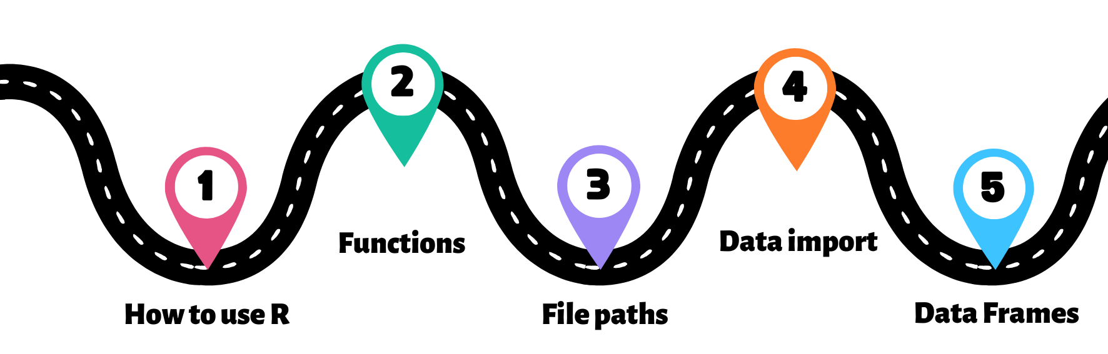
Hold your horses – there is some terrain to be covered…
You are here!
Destination
START
Import a dataset and analyze it with R!

Slide 13


ASK QUESTIONS!
ASK FOR a USE CASE
Don't worry—we're all learning!
We're going to cover a lot. Learning to program takes time and can be hard at first.
It's okay if you don't understand or remember everything. As you code, you'll get better and more comfortable.
Try to have fun during this workshop and don't be afraid to play around with code!

Slide 14
Double click on the .RProj file to open the project in RStudio
Let’s start !

Slide 15
Welcome to RStudio!

Slide 16

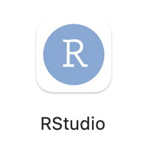
R vs RStuDio
R is a programming language
Runs code, produces output
RStudio is a feature-rich interface that runs on top of R
Makes it easier to write code

Slide 17
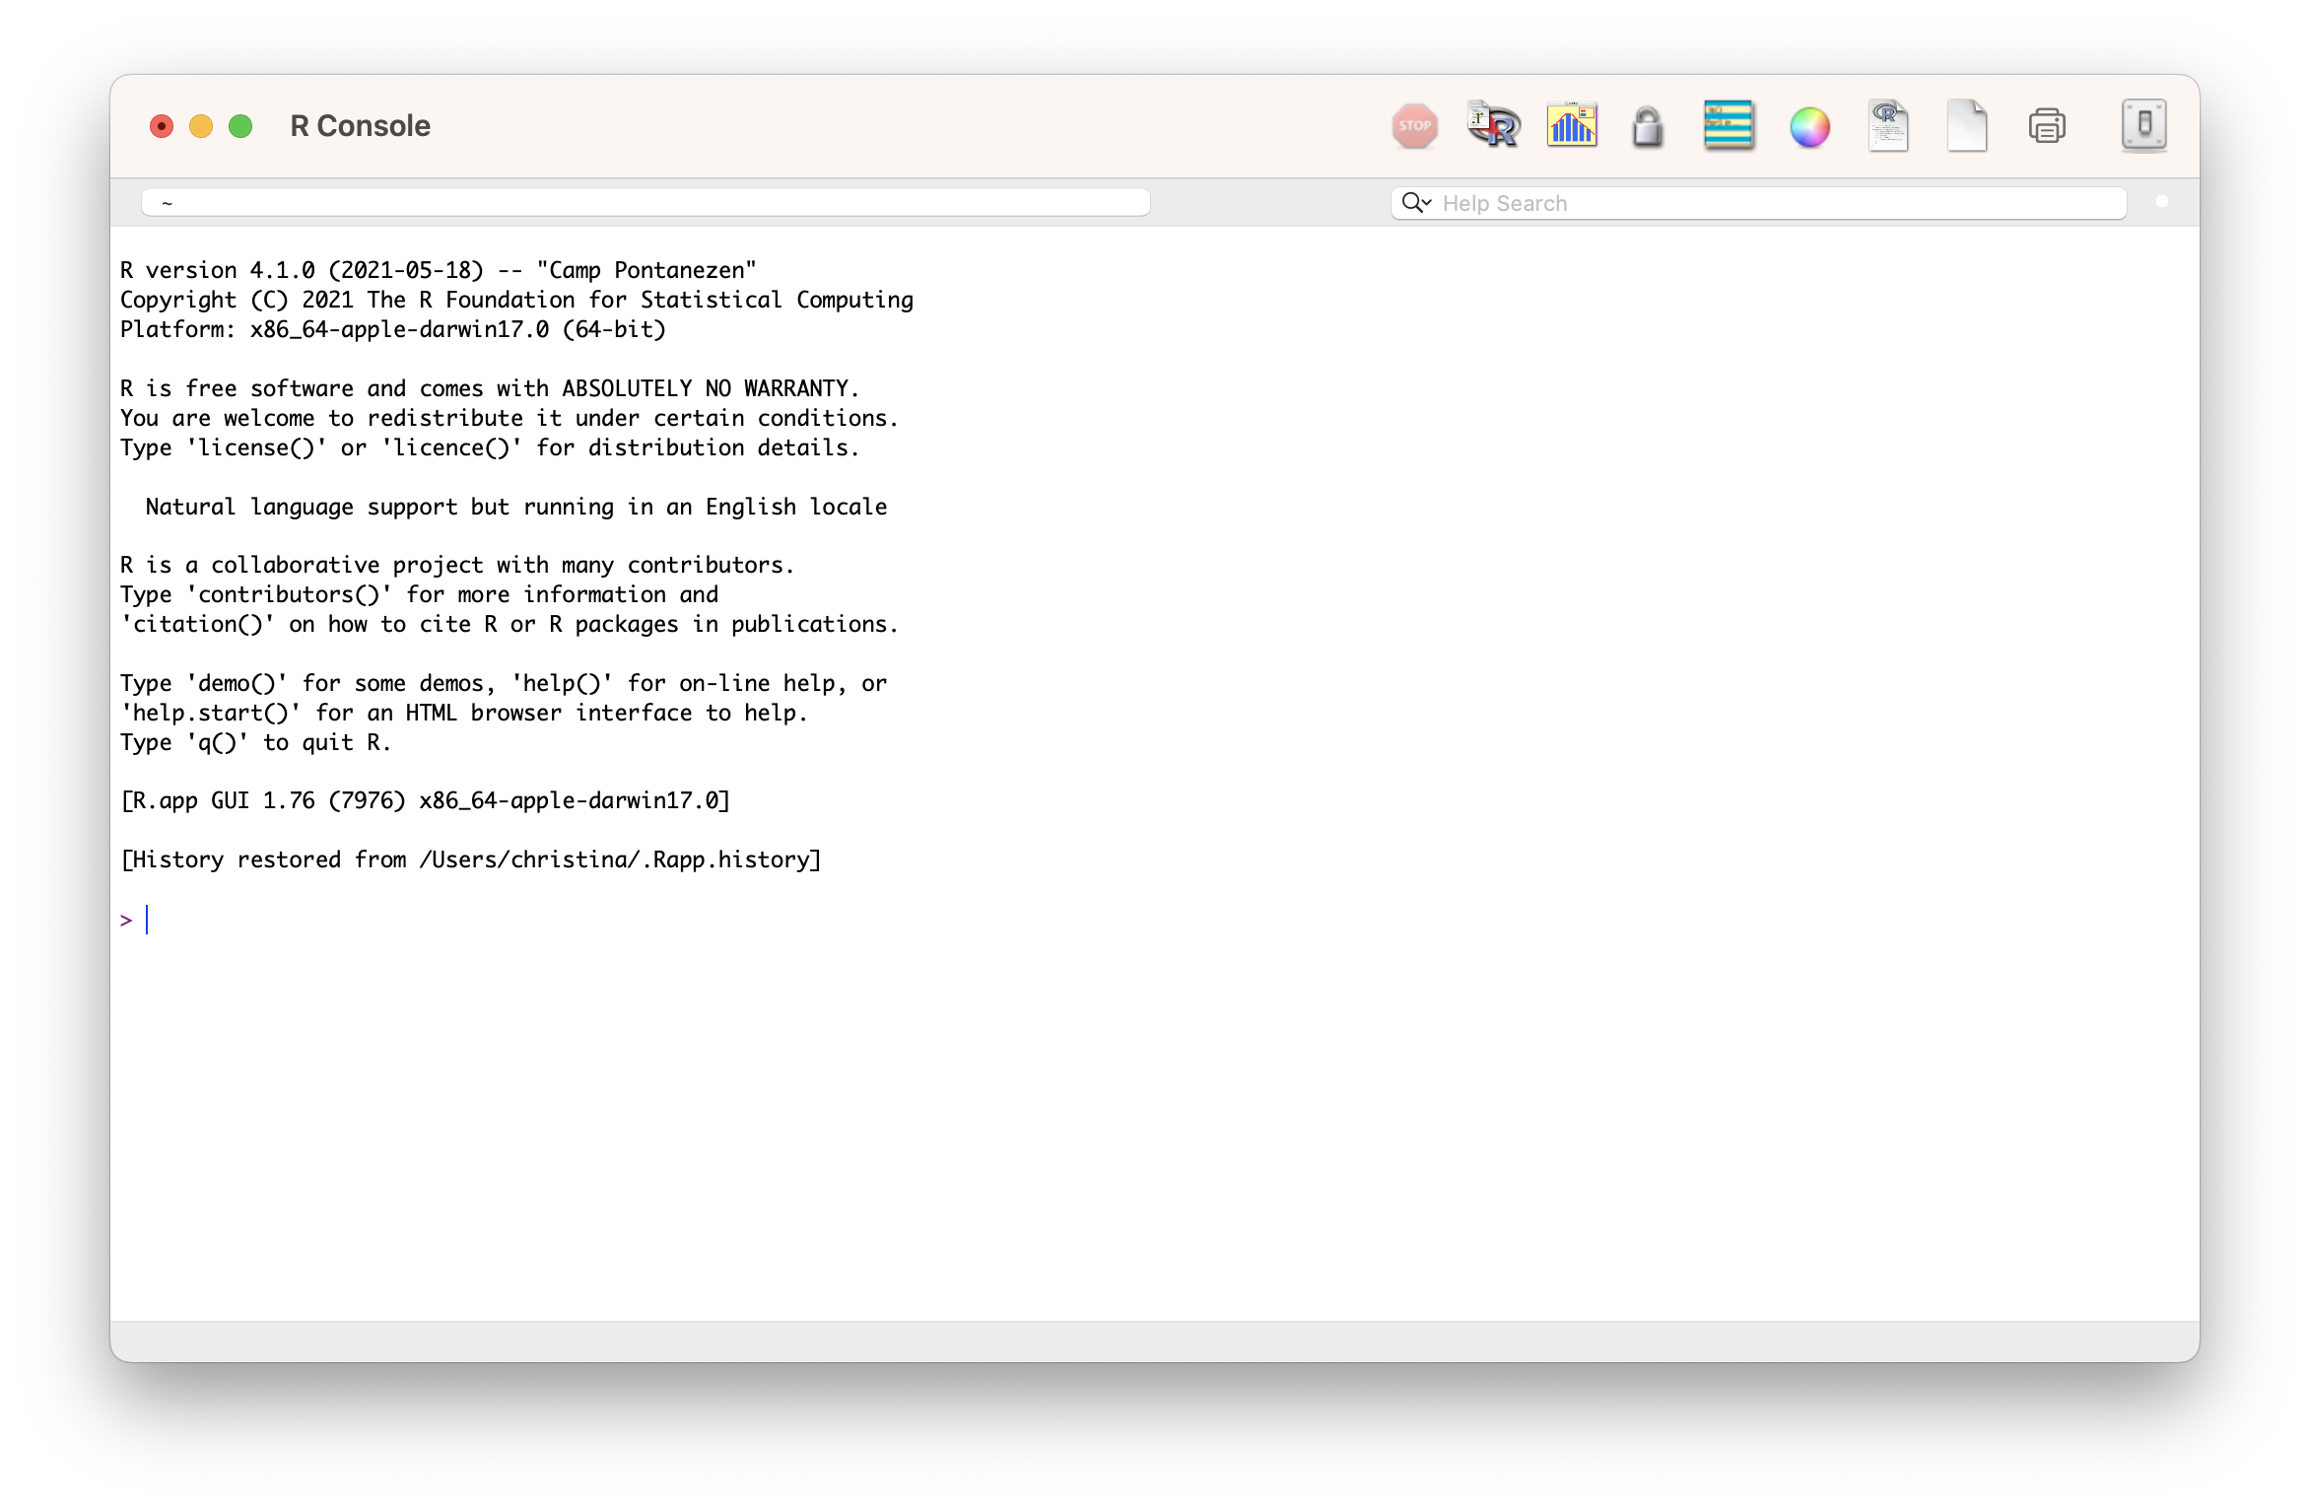

R vs RStuDio

Slide 18
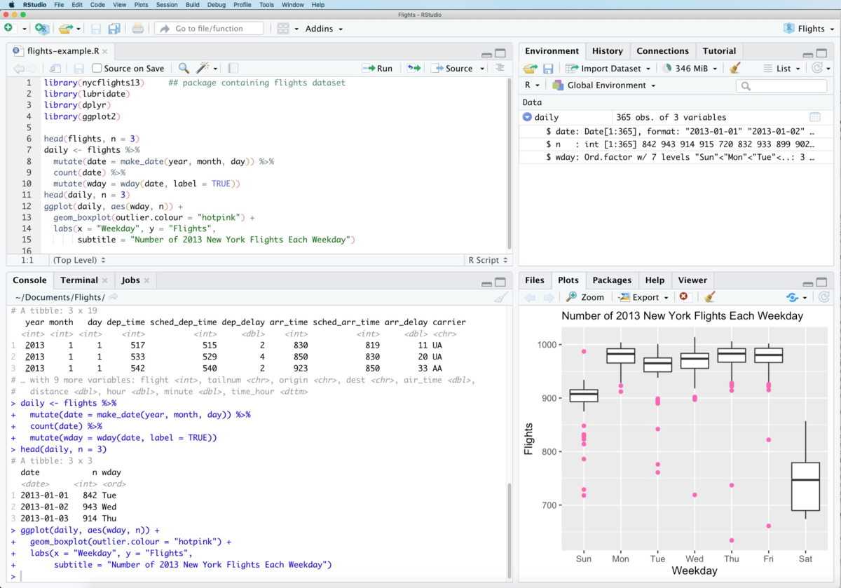

R vs RStuDio

Slide 19
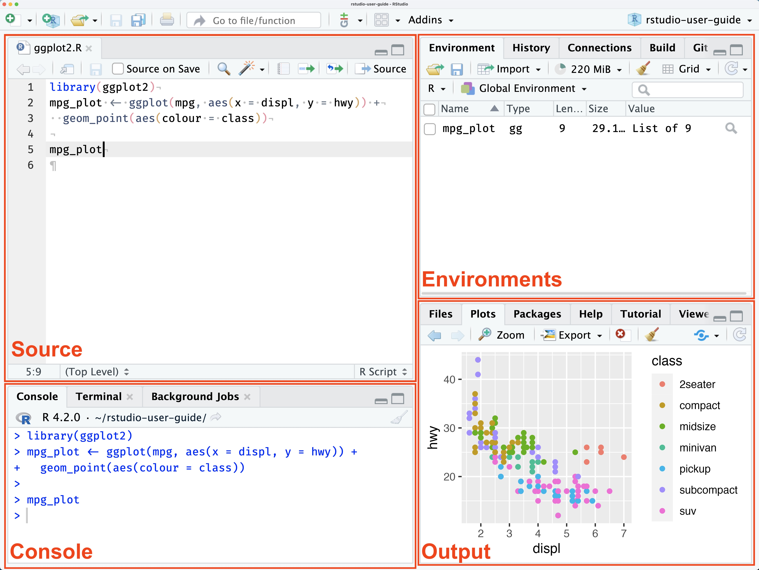
Rstudio pane layout
SOURCE
This is where you write your code!
Your code won’t be evaluated until you “Run” them to the console.
ENVIRONMENT
Here you can see what objects are in your working space
FILES / PACKAGES /PLOTS
Here you can see what file directories, view plots, see your packages, and access R Help
CONSOLE
This is where your code from Source is evaluated by R.
You can also use the console for quick calculations that you don’t need to save.

Slide 20
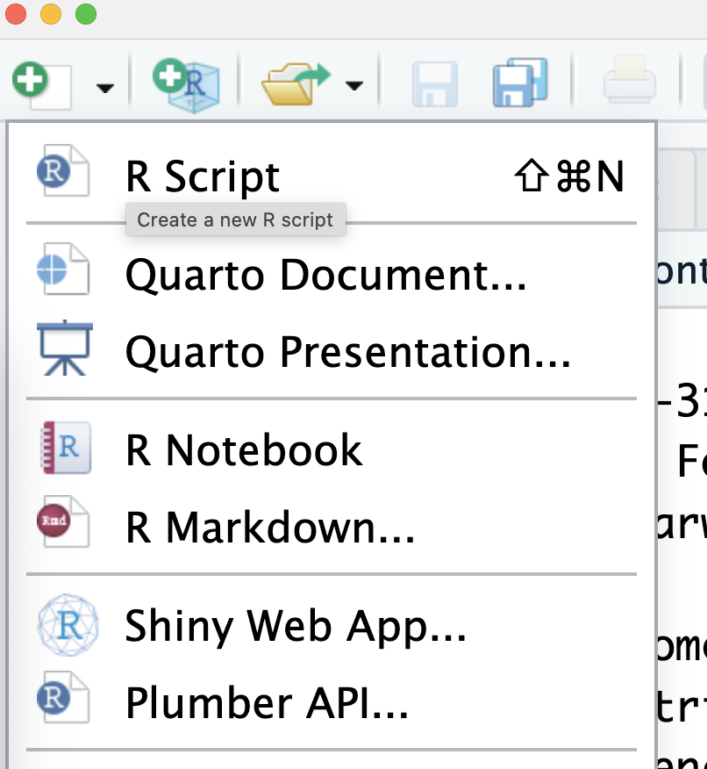
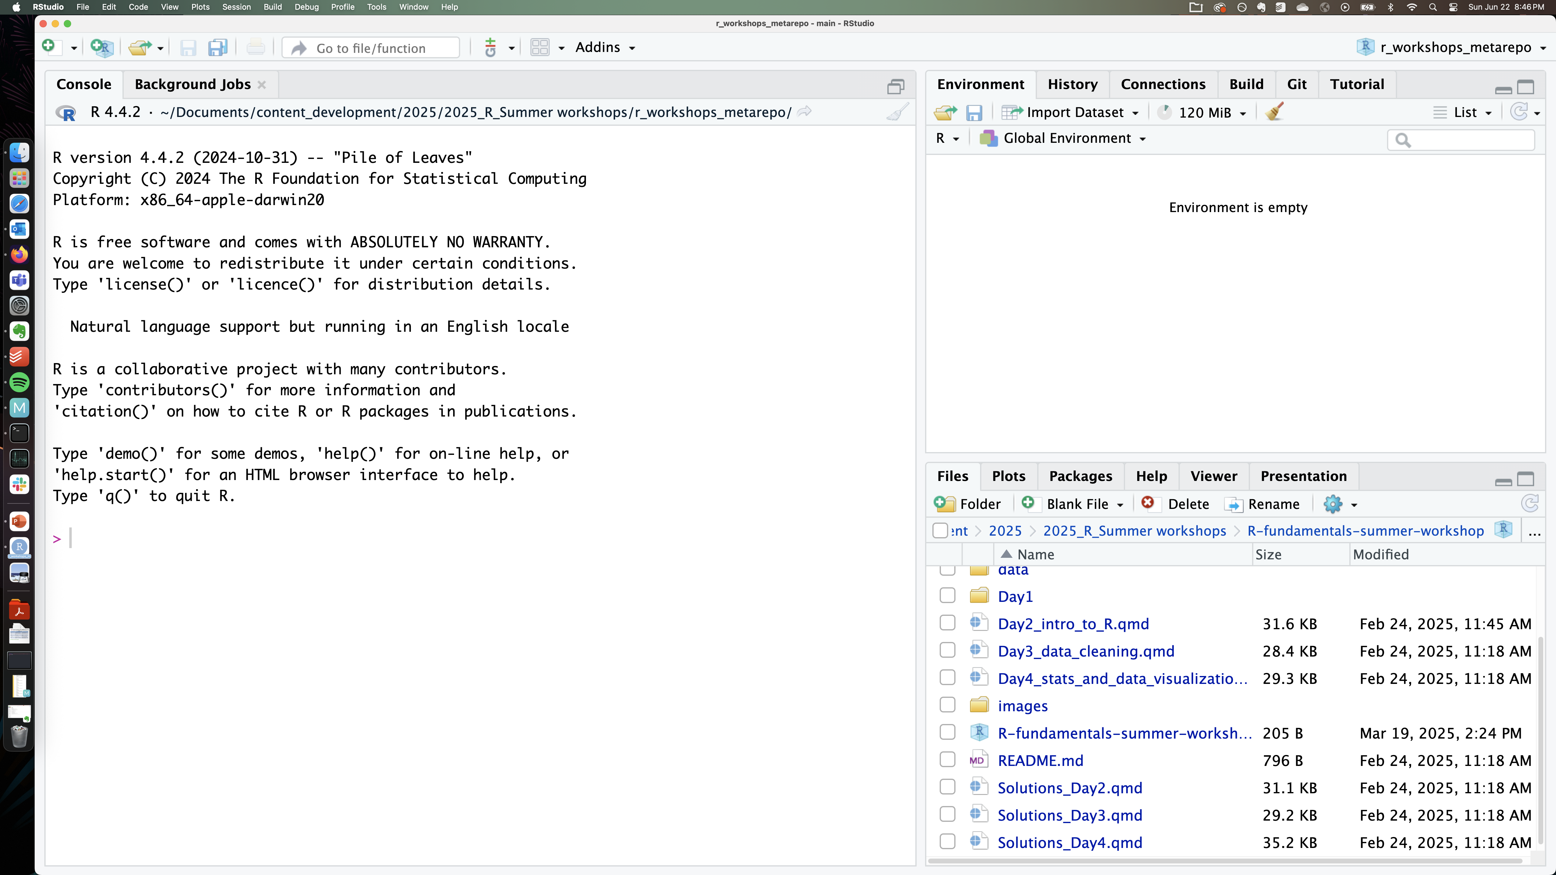
Rstudio pane layout
No SOURCE pane?
If no files are open to write code in, the source tab is minimized.
To see the source pane, open any new file!

Slide 21

TRY IT ..
exercise
Type some math operations in the console and get answers.
Explore the file structure and click on the buttons in the File pane to see what they do!
Warning – deleting files IN r is permanent
The Delete function in the Files pane in RStudio uses the system "Delete" command rather than using the Trash Can/Recycle bin of the system.
We recommend only using the Delete function to remove files or directories that you are sure you want to delete permanently.

Slide 22
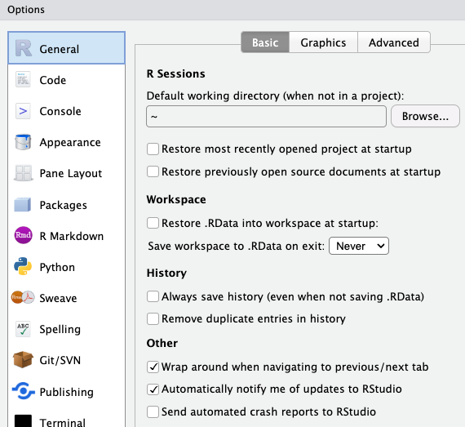
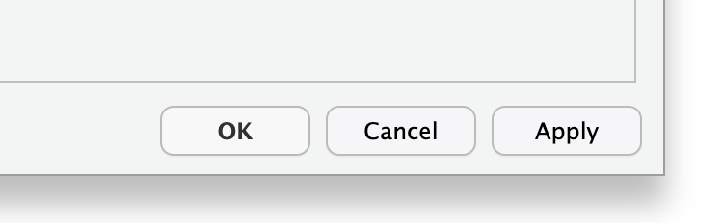
Suggested settings for rstudio
Where:
Tools > Global Options >
General > Basic (tab)
6
Why:
We don’t want to create anything that cannot be reproduced from the R script alone
i.e. no saving history or workspace
Optional
change to a convenient location for you!
1
2
5
3
4
Remember!
Click on “Apply” to apply the new settings

Slide 23
Writing code in R files

Slide 24
Commonly used code-files in rstudio
Popular file formats used by researchers and R coders:
R script (.R)
R Markdown (.Rmd)
Quarto Markdown (.qmd)
Markdown (.md)

Slide 25
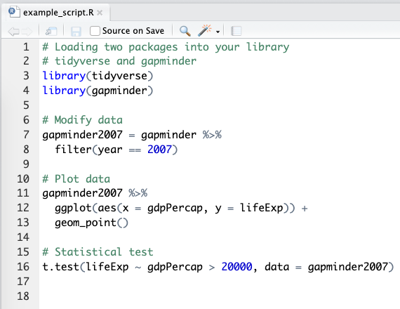
R script file
What:
A script is a list of instructions.
It is a text file. No special software is required to view one.
Notice the file extension – example_script.R
# this is a code comment
Some parts of the script read like normal English. These lines start with a # - they are called “comments”. These are notes of what we are doing, for others and our future selves!
Code lines
Lines that don’t start with # are R code. When the R script is executed by the console, only R code lines will be evaluated and run.

Slide 26
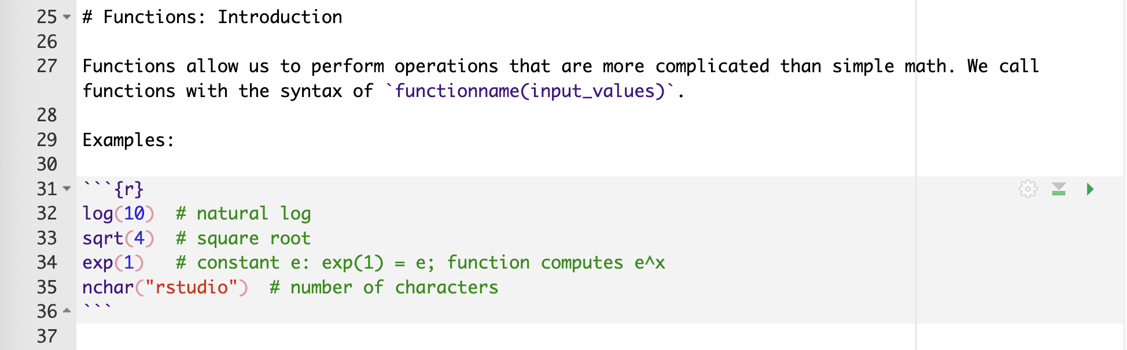
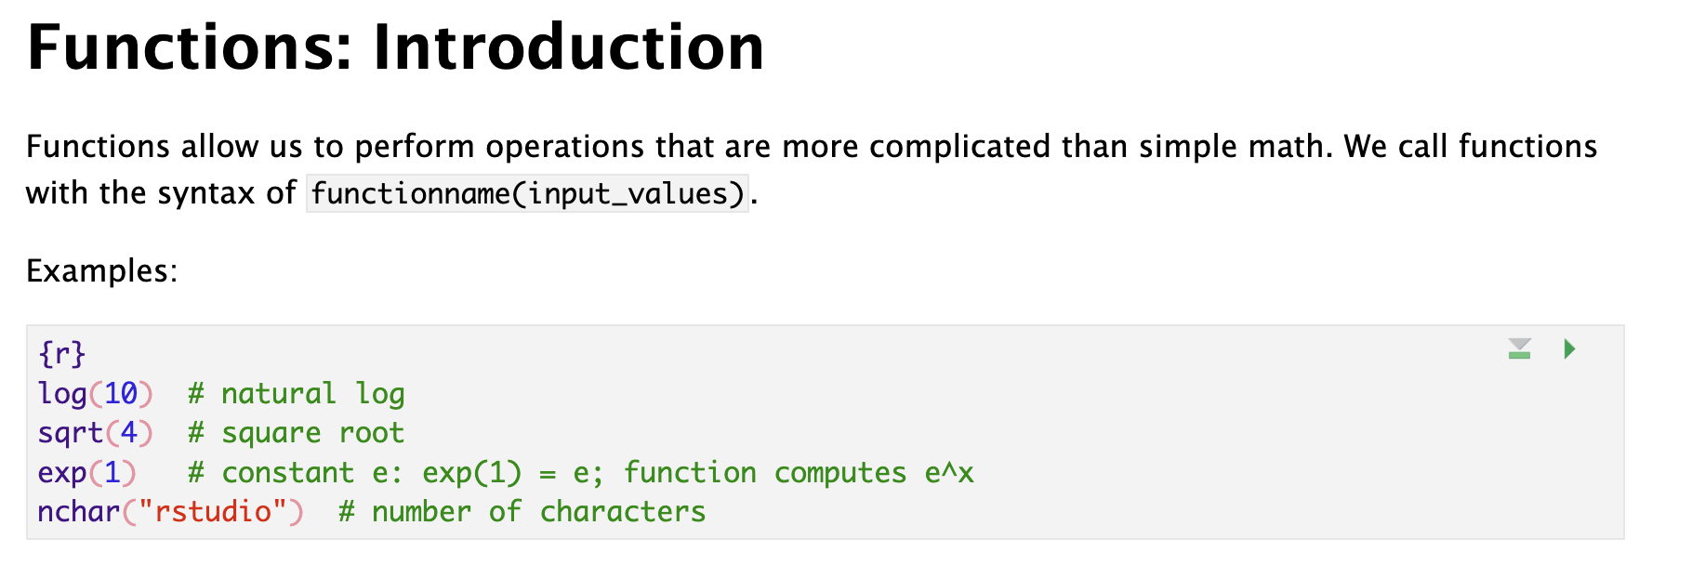
R / Quarto MARKDOWN file
What:
R Markdown is a file format for making dynamic or interactive documents with R.
.Rmd - R Markdown file extension
.qmd – Quarto Markdown file extension
It contains both plain text and code chunks.
R Markdown file in plain text format
Markdown
A markup language for creating formatted text using a plain-text editor.
R Markdown file after rendering
Plain markup text
Write in English (or any language). Use special symbols to indicate formatting, (note how # creates a heading in the example)
Code chunk
```{r}
2 + 2 # code for addition
```
Triple backticks in the format above indicate a code chunk that can be executed through the R console.

Slide 27
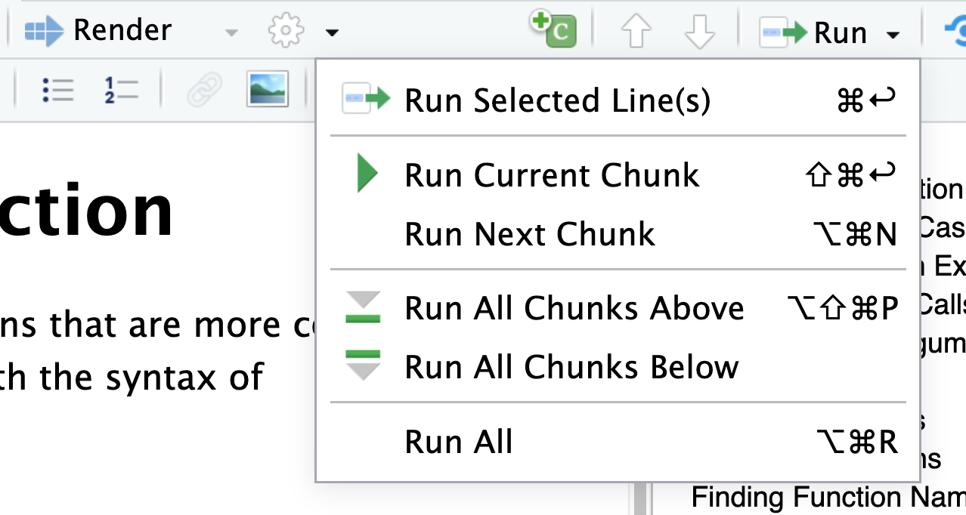
R / Quarto MARKDOWN file – helpful menu buttons
Inserting a code chunk
keyboard shortcut Ctrl + Alt + I (OS X: Cmd + Option + I)
Add chunk menu button in the editor toolbar

Slide 28
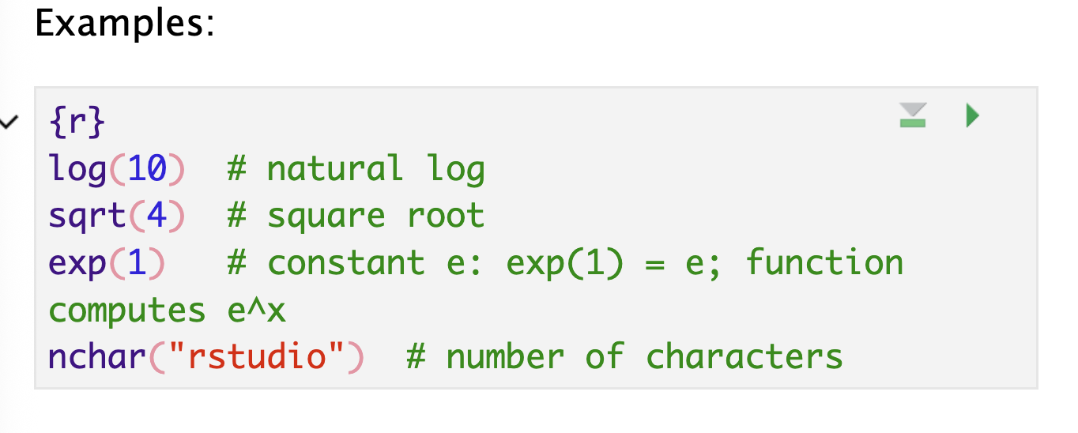
R / Quarto MARKDOWN file – helpful menu buttons
Executing code
Executing a single line
To execute the line of source code where the cursor currently resides press the Ctrl+Enter keys (or use the Run toolbar button). This works for both .R scripts and .Rmd/.qmd files.
Executing multiple lines
Select the lines to run, and press Ctrl+Enter
Select one of the options in the Run Menu drop-down
Some shortcuts are present in the top-right for each chunk:

Slide 29
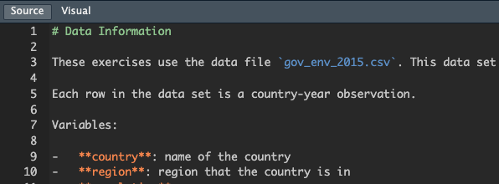
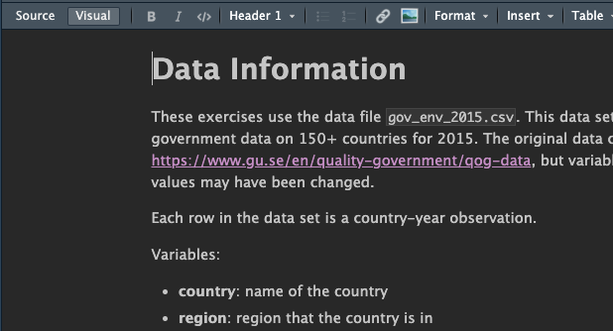
MARKDOWN file
Markdown file in plain text format
Markdown
A markup language for creating formatted text using a plain-text editor.
Only contains plain text. No code chunks.
Plain markup text
Write in English (or any language). Use special symbols to indicate formatting, (note how # creates a heading in the example)
Markdown file after rendering

Slide 30
TRY IT ..
exercise
Open the file welcome.R
Can you spot code lines and comment lines?
Open the file 01_basic_functions.qmd –
Insert a code chunk in this file

Slide 31
Functions

Slide 32
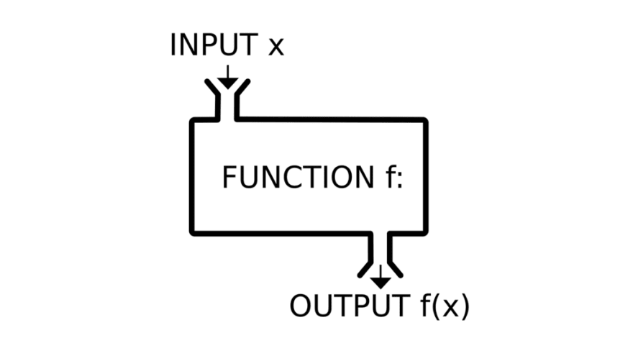
Functions in programming ~ similar to math functions
f(x) = y
Takes input values, also called parameters or arguments
Returns an output value, also called a return value
R functions usually don't alter their input values (but they sometimes do!)

Slide 33
Why should you use functions?
Pieces of code designed to perform specific tasks
You can re-use them multiple times without re-writing the same code
They help you organize your code into manageable chunks
You can use them just knowing their input and output
→ They help you write code that is clearer and less error prone. They also help you conserve your valuable brain power

Slide 34

Let’s look at a useful function..
read.csv(file, header = TRUE, sep = ",", quote = "\"",
dec = ".", fill = TRUE, comment.char = "", ...)
What:
This is the function definition for the function named “read.csv”
It contains the function name, and the inputs it takes inside parentheses
Where:
Type read.csv in the R console to see this definition printed to console.
Type ?read.csv in the R console to see the more details for each input argument in the R Help tab on the File pane of RStudio.
Tip!
You can check the definition of any function with ?function_name

Slide 35
Defining functions
Functions have names
read.csv(file, header = TRUE, sep = ",", quote = "\"",
dec = ".", fill = TRUE, comment.char = "", ...)

Slide 36
Defining functions
Functions can be called with their names using ( )
read.csv(file, header = TRUE, sep = ",", quote = "\"",
dec = ".", fill = TRUE, comment.char = "", ...)

Slide 37
Defining functions
Functions take input parameters or arguments inside ( )
read.csv(file, header = TRUE, sep = ",", quote = "\"",
dec = ".", fill = TRUE, comment.char = "", ...)

Slide 38
Defining functions
Function parameters also have names (parameter names)
read.csv(file, header = TRUE, sep = ",", quote = "\"",
dec = ".", fill = TRUE, comment.char = "", ...)

Slide 39
Defining functions
Some function parameters have default values
read.csv(file, header = TRUE, sep = ",", quote = "\"",
dec = ".", fill = TRUE, comment.char = "", ...)
These are the values the function parameter will take if no values are provided for it by the user

Slide 40
Defining functions
However, some parameters are required parameters!
read.csv(file, header = TRUE, sep = ",", quote = "\"",
dec = ".", fill = TRUE, comment.char = "", ...)
These parameter values need to be provided by the user

Slide 41
Defining functions
Some functions also have additional undefined parameters
read.csv(file, header = TRUE, sep = ",", quote = "\"",
dec = ".", fill = TRUE, comment.char = "", ...)
These are additional values that can be taken by this function but are not explicitly listed in the function definition.
We will see some examples later.

Slide 42
Defining functions
Putting it all together
read.csv(file, header = TRUE, sep = ",", quote = "\"",
dec = ".", fill = TRUE, comment.char = "", ...)
Functions have names, they can be called with ().
Functions take input parameters, which also have parameter names.
Some parameters are required, some have default values, and some others are additional (hidden) parameters.

Slide 43
Calling functions
Functions are called as: function_name(input parameters/args)

Slide 44

Calling functions
Functions are called as: function_name(input parameters/args)
How does R know which value to assign to which input parameter??

Slide 45

Calling functions
Functions are called as: function_name(input parameters/args)
How does R know which value to assign to which input parameter??
by name
by position
by name and position

Slide 46
Calling functions
Defining parameter values by Name
read.csv(file, header = TRUE, sep = ",", quote = "\"",
dec = ".", fill = TRUE, comment.char = "", ...)
read.csv(file=“results.txt”,
header=TRUE,
sep=“\t”)

Slide 47

Calling functions
Defining parameter values by Name
read.csv(file, header = TRUE, sep = ",", quote = "\"",
dec = ".", fill = TRUE, comment.char = "", ...)
read.csv( sep=“\t”,
file=“results.txt”,
header=TRUE)

Slide 48
Calling functions
Defining parameter values by Position
read.csv(file, header = TRUE, sep = ",", quote = "\"",
dec = ".", fill = TRUE, comment.char = "", ...)
read.csv(“results.txt”, TRUE, “\t”)

Slide 49
Calling functions
Defining parameter values by Position
read.csv(file, header = TRUE, sep = ",", quote = "\"",
dec = ".", fill = TRUE, comment.char = "", ...)
1, 2, 3
read.csv(“results.txt”, TRUE, “\t”)

Slide 50
Calling functions
Defining parameter values by Position & Name
read.csv(file, header = TRUE, sep = ",", quote = "\"",
dec = ".", fill = TRUE, comment.char = "", ...)
read.csv(file=“results.txt”, TRUE, “\t”)

Slide 51
Calling functions
Defining parameter values by Position & Name
read.csv(file, header = TRUE, sep = ",", quote = "\"",
dec = ".", fill = TRUE, comment.char = "", ...)
read.csv(file=“results.txt”, TRUE, “\t”)
Match all named arguments first,

Slide 52
Calling functions
Defining parameter values by Position & Name
read.csv(file, header = TRUE, sep = ",", quote = "\"",
dec = ".", fill = TRUE, comment.char = "", ...)
read.csv(file=“results.txt”, TRUE, “\t”)
Match all named arguments first,
Match positions in order – 1

Slide 53
Calling functions
Defining parameter values by Position & Name
read.csv(file, header = TRUE, sep = ",", quote = "\"",
dec = ".", fill = TRUE, comment.char = "", ...)
read.csv(file=“results.txt”, TRUE, “\t”)
Match all named arguments first,
Match positions in order – 1
Match positions in order – 2

Slide 54
Calling functions
Defining parameter values by Position & Name
read.csv(file, header = TRUE, sep = ",", quote = "\"",
dec = ".", fill = TRUE, comment.char = "", ...)
read.csv(header=TRUE, “results.txt”, “\t”)
Let’s try another example..

Slide 55
Calling functions
Defining parameter values by Position & Name
read.csv(file, header = TRUE, sep = ",", quote = "\"",
dec = ".", fill = TRUE, comment.char = "", ...)
read.csv(header=TRUE, “results.txt”, “\t”)
Named arguments matched!

Slide 56
Calling functions
Defining parameter values by Position & Name
read.csv(file, header = TRUE, sep = ",", quote = "\"",
dec = ".", fill = TRUE, comment.char = "", ...)
read.csv(header=TRUE, “results.txt”, “\t”)
Named arguments matched!
Position 1 matched to first leftover argument

Slide 57
Calling functions
Defining parameter values by Position & Name
read.csv(file, header = TRUE, sep = ",", quote = "\"",
dec = ".", fill = TRUE, comment.char = "", ...)
read.csv(header=TRUE, “results.txt”, “\t”)
Named arguments matched!
Position 1 matched to first leftover argument
Position 2 matched to second leftover argument

Slide 58
Quiz Time!
Will this function call work?
read.csv(file, header = TRUE, sep = ",", quote = "\"",
dec = ".", fill = TRUE, comment.char = "", ...)
read.csv("results.txt", sep="\t")
read.csv("results.txt", "\t")
read.csv("results.txt", TRUE, "\t")

Slide 59
Quiz Time!
Will this function call work?
read.csv(file, header = TRUE, sep = ",", quote = "\"",
dec = ".", fill = TRUE, comment.char = "", ...)
read.csv("results.txt", sep="\t")

Slide 60

Quiz Time!
Will this function call work?
read.csv(file, header = TRUE, sep = ",", quote = "\"",
dec = ".", fill = TRUE, comment.char = "", ...)
read.csv("results.txt", sep="\t")
Named argument sep is matched with value “\t”
First value “results.txt” is matched to first argument file

Slide 61
Quiz Time!
Will this function call work?
read.csv(file, header = TRUE, sep = ",", quote = "\"",
dec = ".", fill = TRUE, comment.char = "", ...)
read.csv("results.txt", "\t")

Slide 62

Quiz Time!
Will this function call work?
read.csv(file, header = TRUE, sep = ",", quote = "\"",
dec = ".", fill = TRUE, comment.char = "", ...)
read.csv("results.txt", "\t")
There are no named arguments
First value “results.txt” is matched to first argument file
Second value “\t” is matched to second argument header

Slide 63
Quiz Time!
Will this function call work?
read.csv(file, header = TRUE, sep = ",", quote = "\"",
dec = ".", fill = TRUE, comment.char = "", ...)
read.csv("results.txt", TRUE, "\t")

Slide 64
Quiz Time!
Will this function call work?
read.csv(file, header = TRUE, sep = ",", quote = "\"",
dec = ".", fill = TRUE, comment.char = "", ...)
read.csv("results.txt", TRUE, "\t")
There are no named arguments
First value “results.txt” is matched to first argument file
Second value TRUE is matched to second argument header
Third value “\t” is matched to third argument sep

Slide 65
Returning values
The output of a function is its return value
Function call
Return value
abs(-3)
3
But this output value is not saved!
How do we save this value??
We can save it by assigning the return value to a variable!
x <- abs(-3)

Slide 66
Half-way there!
You are here!
Destination
START
Import a dataset and analyze it with R!

Slide 67
File Paths

Slide 68
File paths
How do we tell R where our files are without using point and click interfaces?
Every file has an absolute path, which starts with the root
An absolute path makes no assumptions about your current location. It starts from the start of your hard drive and describes every step to get to a file. The root is that start—it's the starting point to organize all files on your computer

Slide 69
EXAMPLE OF AN ABSOLUTE PATH
Earth → North America → United States → Illinois → Evanston → Tech Drive → 2233 Mudd → My office!

Slide 70
PC (Windows)
c:

Slide 71

C:\
PC (Windows)
c:
Program Files
Users
System

Slide 72
C:\Users\
PC (Windows)
c:
Program Files
Users
System
ritika
guest

Slide 73
C:\Users\ritika\
PC (Windows)
c:
Program Files
Users
System
ritika
guest
Documents
Desktop
Music
Photos

Slide 74
C:\Users\ritika\Documents\
PC (Windows)
c:
Program Files
Users
System
ritika
guest
Documents
Desktop
Music
Photos
dissertation
my_project

Slide 75

C:\Users\ritika\Documents\my_project
PC (Windows)
c:
Program Files
Users
System
ritika
guest
Documents
Desktop
Music
Photos
dissertation
my_project
data.csv
process.py
DRAFT.docx

Slide 76
C:\Users\ritika\Documents\my_project\data.csv
PC (Windows)
c:
Program Files
Users
System
ritika
guest
Documents
Desktop
Music
Photos
dissertation
my_project
data.csv
process.py
DRAFT.docx

Slide 77
/Users/ritika/Documents/my_project/data.csv
MacOS
/
Applications
Users
System
ritika
guest
Documents
Desktop
Music
Photos
dissertation
my_project
data.csv
process.py
DRAFT.docx

Slide 78
Absolute Paths
C:\Users\ritika\Documents\my_project\data.csv
/Users/ritika/Documents/my_project/data.csv
R is not able to understand normal Windows paths correctly because the "\" has special meaning - it is used as escape character to give following characters special meaning (\n for newline, \t for tab, etc.)
For windows:
Replace the "\" with "/" , or
Replace the "\" with "\\" , - an additional escape character escapes the special meaning

Slide 79
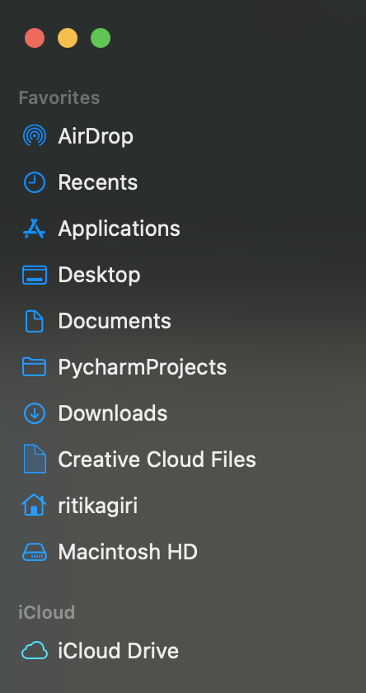
Home Directory
The home directory is a personal directory assigned to a user.
The root directory is the starting point of the whole computer, while the home directory is specific to a user.

Slide 80
Home Directory: C:\Users\ritika = ~
c:
Program Files
~
Users
System
ritika
guest
Documents
Desktop
Music
Photos
dissertation
my_project
data.csv
process.py
DRAFT.docx

Slide 81
~/Documents/my_project/data.csv
c:
Program Files
Users
System
ritika
guest
Documents
Desktop
Music
Photos
dissertation
my_project
data.csv
process.py
DRAFT.docx

Slide 82
Working Directory
A directory in the file system associated with a running process or program (aka "where you're working from")
>> Where R starts when looking for files
>> Uses Relative File Paths

Slide 83
EXAMPLE OF A RELATIVE PATH
Remember our absolute path: Earth → North America → United States → Illinois → Evanston → Tech Drive → 2233
The relative path (relative to Illinois) would be: Evanston → Tech Drive → 2233

Slide 84
Relative Path from Documents: my_project/data.csv
c:
Program Files
Users
System
ritika
guest
Documents
Desktop
Music
Photos
dissertation
my_project
data.csv
process.py
DRAFT.docx

Slide 85
From ritika:
c:
Program Files
Users
System
ritika
guest
Documents
Desktop
Music
Photos
dissertation
my_project
data.csv
process.py
DRAFT.docx
Notes:
Documents/my_project/data.csv

Slide 86
From ritika: Documents/my_project/data.csv
c:
Program Files
Users
System
ritika
guest
Documents
Desktop
Music
Photos
dissertation
my_project
data.csv
process.py
DRAFT.docx
Notes:
Documents/my_project/data.csv

Slide 87
.. means go up a level

Slide 88
From Desktop: ../Documents/my_project/data.csv
c:
Program Files
Users
System
ritika
guest
Documents
Desktop
Music
Photos
dissertation
my_project
data.csv
process.py
DRAFT.docx
Notes:
Documents/my_project/data.csv

Slide 89
From dissertation: ../my_project/data.csv
c:
Program Files
Users
System
ritika
guest
Documents
Desktop
Music
Photos
dissertation
my_project
data.csv
process.py
DRAFT.docx
Notes:
Documents/my_project/data.csv

Slide 90
How to find paths in your computer?
Mac:
Right click on a file > Get info ("Where")
Windows:
Right click on a file > Properties ("Location")
Or clicking in the box that contains the file name (above the list of files inside the folder)

Slide 91
Store Project Files Together
project_directory
code
process_data.r
make_graphs.r
estimate_model.r
data
people.csv
exam1.csv
output
impact_plot.pdf
reports
chapter1.docx
working directory

Slide 92
But what is the Working Directory for R?
Default: home directory of the user (~)
RStudio Projects: the folder you associate with the project
>> You can set or change the working directory
getwd()
Ask R to tell you where the working directory is now
setwd(“your-desired-path”)
Tell R to set working directory to your-desired-path

Slide 93
RStudio Projects

Slide 94
RStudio Projects
RStudio projects make it straightforward to divide your work into multiple contexts, each with their own working directory, workspace, history, and source documents.
You can create an RStudio project:
In a brand-new directory
In an existing directory which has R code and/or data
By cloning a version control (eg: Git) repository

Slide 95
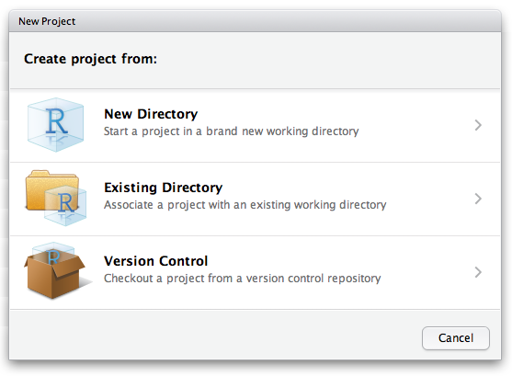
RStudio Projects
RStudio projects make it straightforward to divide your work into multiple contexts, each with their own working directory, workspace, history, and source documents.
To create a new project in the RStudio IDE, use the Create Project command (available on the Projects menu and on the global toolbar)

Slide 96
GETTING THERE!!
Destination
You are here!
START
Import a dataset and analyze it with R!

Slide 97

R Packages

Slide 98
R packages
What:
R packages are extensions to the R programming language
Contain code, data, and documentation in a standardized format that can installed by other R users
Examples of useful packages:
haven (Enables R to read and write data from SAS, SPSS, and Stata)
ggplot2 (R's famous package for making beautiful graphics)
survival (Tools for survival analysis)
Why:
Enable re-use of code within the R ecosystem in a reproducible manner
Using a package:
Packages need to be installed on your computer and then loaded into your R session before you can use them. Packages are stored in a directory on your computer called a library.
Finding a package:
You can search for packages on CRAN or by using “task views”, which organize packages by specific areas of application. (CRAN - https://cran.r-project.org/web/packages/)

Slide 99
using R packages
Installing a package
# run this command to install a desired package
install.packages(“package-name”)
Loading a package
# run this command to use the package
library(package-name)
# notice - no quotes for package-name
What R does when you install
package-name will be found on a repository (eg. CRAN), downloaded to your local machine, and stored in the library folder
What R does when you load
package-name will be found in the library folder of your computer, and loaded into RAM (memory) for easy access in your current R session
You only install once!
Once package-name is installed on your machine it lives on your hard drive and doesn’t need to be installed again (except for package updates, where the updated version is downloaded fresh from the repo).
You load every *RAM* time!
Every fresh R session will require loading package-name into RAM for use during that session. When you close out R, the RAM for that session is refreshed and all loaded packages are lost.

Slide 100

TRY IT ..
exercise
Install the following packages on your computer
tidyverse
janitor
Now, use the library command to load them into your R session
Installing a package
install.packages(“package-name”)
Loading a package
library(package-name)

Slide 101
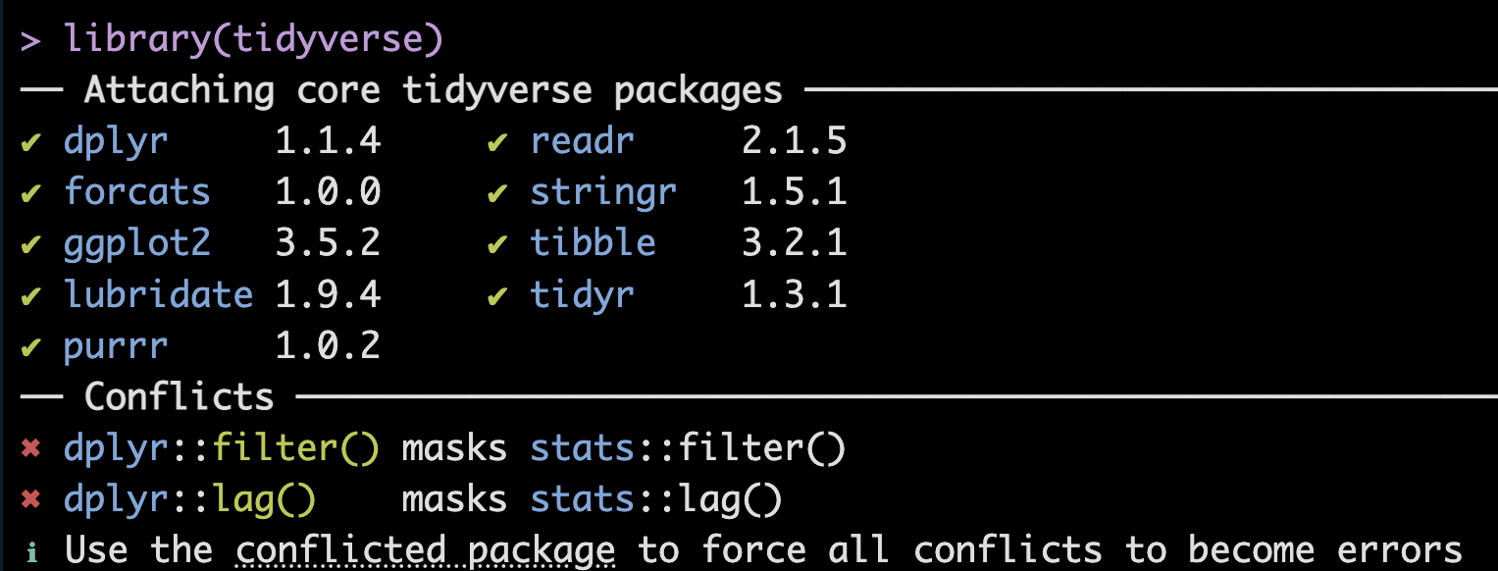
using R packages
In R, multiple packages can have functions with the same name. When you load such packages, R uses the most recently loaded version of the function.
A namespace conflict means:
"Two packages define the same function name, and R has to choose which one to use."
In this instance,
base R stats package has functions named filter, and lag
dplyr also has functions named filter, and lag
So the console message is telling you that dplyr::filter() and dplyr::lag() will be called if filter and lag functions are called without specifying which package to use.

Slide 102
Data Frames

Slide 103

Data Frames: Rectangles of Data
View(data)
variables/
features
observations
values

Slide 104
Rows: Observations
nrow(data)
Person (or mouse, worm, etc.)
Country
Year
Run/trial of an experiment
Chemical
Sample

Slide 105
Columns: Variables
ncol(data)
Measurements
Grouping/identification variables:
> trial/sample
> condition
> label for the observation (country name)
Each ID variable in its own column

Slide 106
THERE!!
Destination
You are here!
START
Import a dataset and analyze it with R!

Slide 107
Open the file Importing_data.qmd
{ CODE SESSION }

Slide 108
{ Quick Review }

Slide 109
Variables
Assigning values to variables
x = 3
x <- 3
Variable name
"Left hand side"
Value
"Right hand side"
Assignment
operator

Slide 110
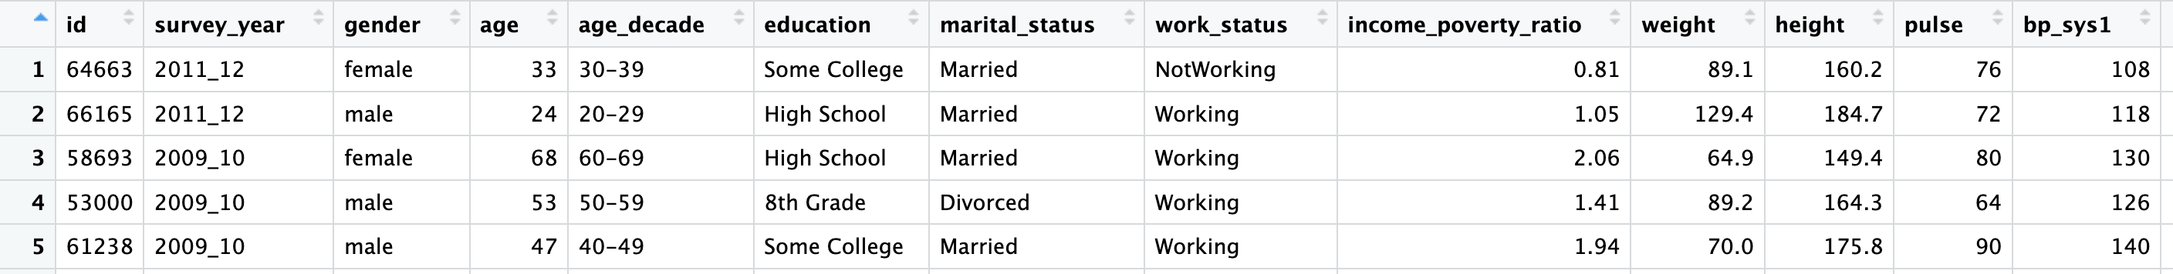
Data Frames – the NHANES data set
View(data)

Slide 111
Data Frames: The $ operator
Access columns by names as:
data$column
Example
healthdata$age

Slide 112
Data Frames: Indexing
Access rows or columns by indexing as:
data [ rows , columns ]
Example
healthdata[1:5 , 3:10 ]

Slide 113
Indexing Values in a Vector
Retrieving single elements from a vector
Indexing –giving a unique number to each element based on its position in the list
Indices in R start from 1
Position/Index: 1 2 3 4
x <- c(2, 4, 7, 8)

Slide 114
Selecting elements from a vector
elements of a vector can be selected using [ ]
The position/index goes inside [ ]
x <- c(2, 4, 7, 8)
x[1] stores 2
x[2] stores 4
Note that ( ) usually denotes a function call, while [ ] denotes index/subset in R

Slide 115
Boolean Operations

Slide 116
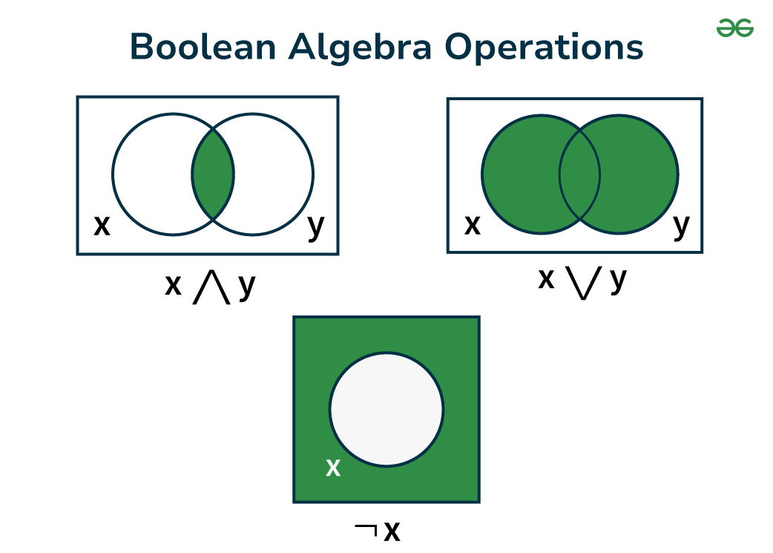
Boolean / Logical operators:
What:
Logical operators are used to compare the output of two comparisons.
There are three types of logical operators in R
AND ( & )
OR ( | )
NOT ( ! )
Output
1 , TRUE
0 , FALSE
NA (missing)
AND
OR
NOT
x & y
x | y
!x

Slide 117
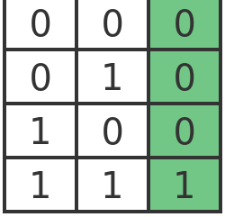
Boolean operator: AND
both conditions must be TRUE
X
Y
AND
OR
NOT
x & y
x | y
!x

Slide 118
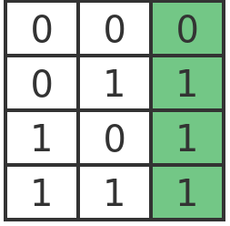
Boolean operator: OR
at least 1 condition must be TRUE
X
Y
AND
OR
NOT
x & y
x | y
!x

Slide 119
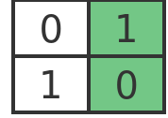
Boolean operator: NOT
condition must be NOT TRUE
= condition must be FALSE
X
!X
AND
OR
NOT
x & y
x | y
!x

Slide 120
TRY IT ..
exercise
# evaluate the following in the R console (or predict)
TRUE & FALSE
TRUE | TRUE
FALSE | TRUE
!TRUE & !TRUE
FALSE | !TRUE
!FALSE & TRUE
FALSE | !FALSE | TRUE
Work out the individual expressions to TRUE or FALSE first,
then compute the answer according to the Boolean logic tables

Slide 121

Open the file CODE_SPRINT_data_analysis.md
{CODE SPRINT}

Slide 122
Open the file CODE_SPRINT_data_viz.md
{CODE SPRINT}

Slide 123
Open the file CODE_SPRINT_statistics.md
{CODE SPRINT}

Slide 124
Feedback survey

